Slide 1
jQuery HTML-CSS

Slide 2
jQuery html()
jQuery html() method is used to change the entire content of the selected elements.
It replaces the selected element content with new contents.
Syntax:
$(selector).html()
It is used to return content.
$(selector).html(content)
It is used to set content.
$(selector).html(function (index, currentcontent))
It is used to set content by calling function.

Slide 3
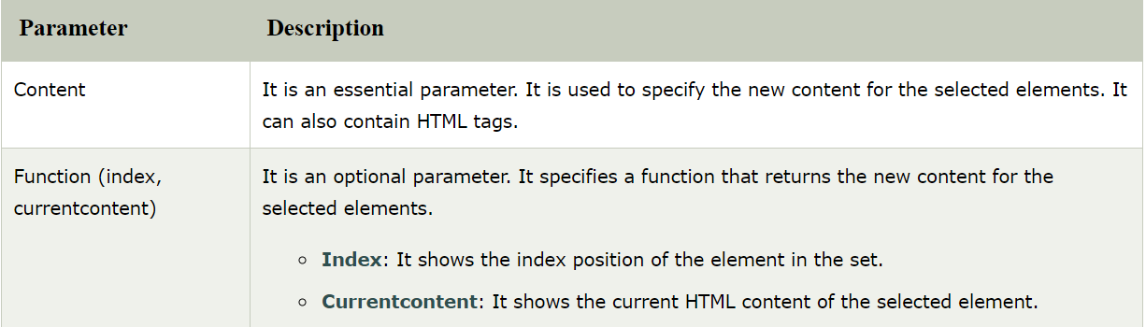
To set content: When you use this method to set content, it overwrites the content of the all matched elements.
To return content: When you use this method to return content, it returns the content of the first matched element.
Parameters

Slide 4
jQuery text()
The jQuery text() method is used to set or return the text content of the selected elements.
To return content: When this method is used to return content, it returns the combined text content of all matched elements without the HTML markup.
To set content: When this method is used to set content, it overwrites the content of all matched elements.

Slide 5
Syntax
To return text content:
$(selector).text()
To set text content:
$(selector).text(content)
To set text content using a function:
$(selector).text(function(index, currentcontent))

Slide 6
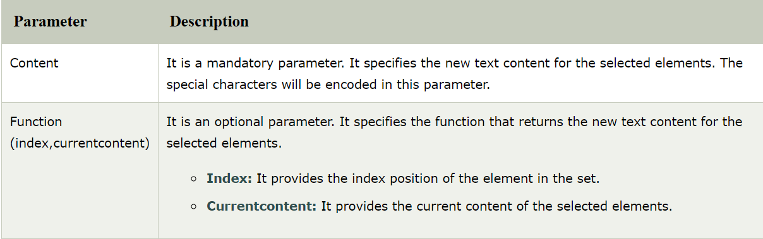
Parameter

Slide 7
jQuery val()
There are two usage of jQuery val() method.
It is used to get current value of the first element in the set of matched elements.
It is used to set the value of every matched element.
Syntax:
$(selector).val()
It is used to get value.
$(selector).val(value)
It is used to set value.
$(selector).val(function(index,currentvalue))
It is used to set value using function.

Slide 8
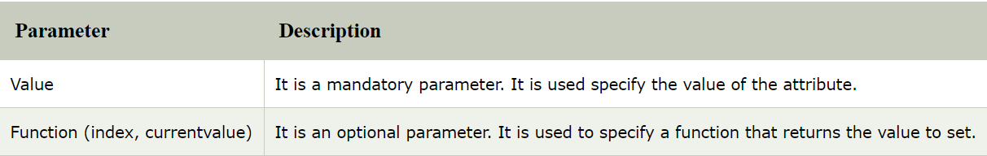
Parameter
The val() method is primarily used to get the values of form elements.
This method doesn't accept any arguments.
This method returns a NULL when no option is selected and it returns an array containing the value of each selected options in the case of one or more selection.

Slide 9
jQuery css()
The jQuery CSS() method is used to get (return)or set style properties or values for selected elements.
It facilitates you to get one or more style properties.
jQuery CSS() method provides two ways:
1) Return a CSS property
It is used to get the value of a specified CSS property.
Syntax:
css("propertyname");

Slide 10
2) Set a CSS property
This property is used to set a specific value for all matched element.
Syntax:
css("propertyname","value");
3) Set multiple CSS properties
It is just an extension of Set CSS property. It facilitates you to add multiple property values together.
Syntax:
css({"propertyname":"value","propertyname":"value",...});

Slide 11
jQuery before()
The jQuery before() method is used to insert the specified content before the selected elements.
It adds the content specified by the parameter, before each element in the set of matched elements.
Syntax:
$(selector).before(content, function(index))

Slide 12
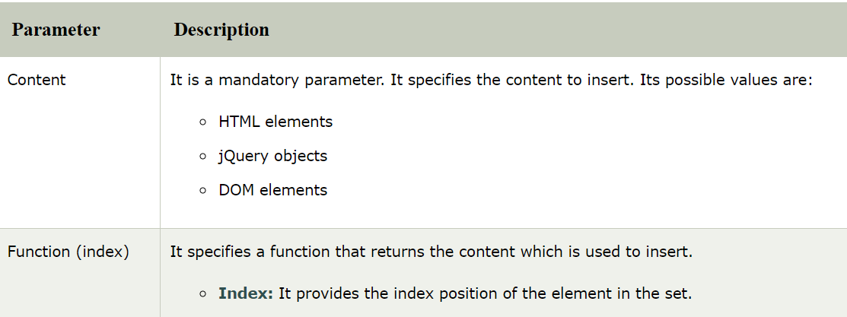
Parameters

Slide 13
jQuery prepend()
The jQuery prepend() method is used to insert the specified content at the beginning (as a first child) of the selected elements.
It is just the opposite of the jQuery append() method.
If you want to insert the content at the end of the selected elements, you should use the append method.
Syntax:
$(selector).prepend(content,function(index,html))

Slide 14
jQuery after()
The jQuery after() method is used to insert specified content after the selected element. It is just like jQuery append() method.
Syntax:
$(selector).after(content,function(index))

Slide 15
jQuery insertAfter()
The jQuery after() and jQuery insertAfter() both methods are used to perform the same task of inserting additional contents after the selected elements.
Difference between jQuery after() and insertAfter()
The main difference between after() and insertAfter is in syntax and placement of the content and target.
In after() method, target is the selected element and content is placed as an argument of the method.
$(target).after(contentToBeInserted)
In insertAfter() method, content is the selected element and target is placed as an argument of the method.
$(contentToBeInserted).insertAfter(target)

Slide 16
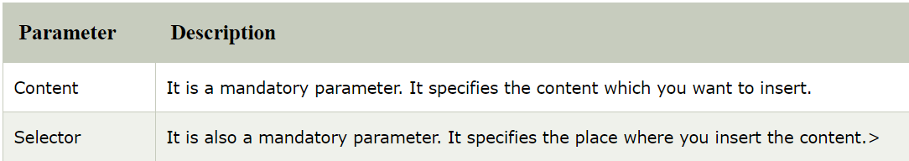
Syntax
$(content).insertAfter(selector)
Parameters

Slide 17
jQuery append()
The jQuery append() method is used to insert specified content as the last child (at the end of) the selected elements in the jQuery collection.
The append () and appendTo () methods are used to perform the same task. The only difference between them is in the syntax.
Syntax:
$(selector).append(content, function(index, html))

Slide 18
jQuery appendTo()
The appendTo() method is used to add additional content at the end of the selected elements.
It is same as jQuery append() method. There is only syntactical difference between append() and appendTo() methods.
Syntax:
$(content).appendTo(selector)

Slide 19
jQuery clone()
The jQuery clone() method is used to make copies of the set of matched elements.
It also makes copies of their child nodes, texts and attributes.
The clone() method is a convenient way to duplicate elements on a page.
Syntax:
$(selector).clone(true|false)

Slide 20
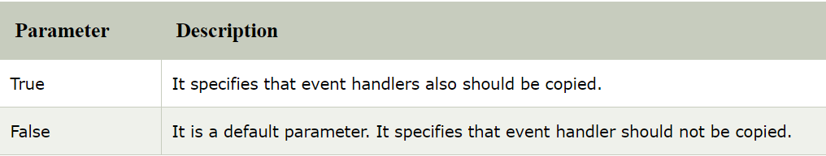
Parameters

Slide 21
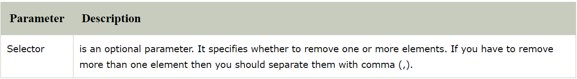
jQuery remove()
The jQuery remove() method is used to remove the selected elements out of the DOM.
It removes the selected element itself, as well as everything inside it (including all texts and child nodes).
This method also removes the data and the events of the selected elements.
Syntax:
$(selector).remove(selector)

Slide 22
jQuery empty()
The jQuery empty() method is used to remove all child nodes and content from the selected elements.
This method doesn't remove the element itself.
Syntax:
$(selector).empty()

Slide 23
jQuery detach()
The jQuery detach() method is used to remove the selected elements, including all texts and child nodes and keeps only data and events.
This method saves a copy of the removed elements to reinsert them whenever they needed later.
There are some other methods also which are used to remove elements e.g. jQuery remove() method, jQuery empty() method etc. But there is a little difference among them.
jQuery remove() method: This method is used to remove the elements as well as its data and events.
jQuery empty() method: This method is used to remove only the content from the selected elements.
Syntax:
$(selector).detach()

Slide 24
Difference
hide -> throw a clothe onto it
empty -> remove the notes with an eraser
detach -> grab the paper in your hand and keep it there for whatever
future plans
remove -> grab the paper and throw it to the dustbin
The paper represents the element, and the notes represent the contents (child nodes) of the element.

Slide 25
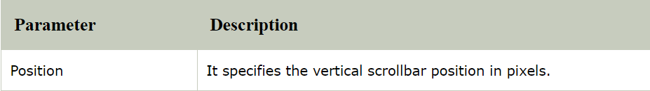
jQuery scrollTop()
The jQuery scrollTop method is used to set or return the vertical scrollbar position for the selected element.
When the scrollbar is on the top, it specifies the position 0.
To return the position: When this method is used to return the position, it provides the current vertical position of the first matched element in the set.
To set the position: When this method is used to set the position, it sets the vertical position of the scrollbar for all matched element.
Syntax:
To return vertical scrollbar position:
$(selector).scrollTop()

Slide 26
jQuery attr()
The jQuery attr() method is used to set or return attributes and values of the selected elements.
There are two usage of jQuery attr() method.
To return attribute value: This method returns the value of the first matched element.
To set attribute value: This method is used to set one or more attribute/value pairs of the set of matched elements.
Syntax:
To return an attribute's value:
$(selector).attr(attribute)
To set an attribute and value:
$(selector).attr(attribute,value)
To set an attribute and value by using a function:
$(selector).attr(attribute,function(index,currentvalue))
To set multiple attributes and values:
$(selector).attr({attribute:value, attribute:value,...})

Slide 27
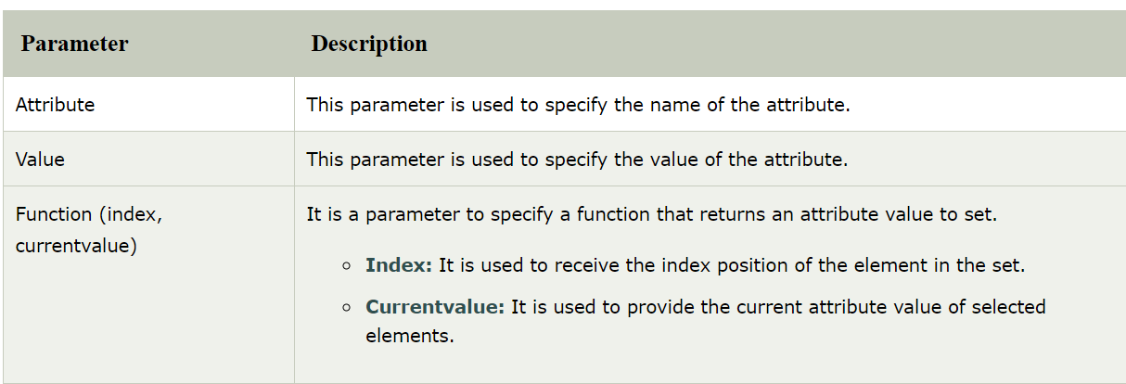

Slide 28
Benefits of using jQuery attr() method
Convenience: When you use jQuery attr() method to get the value of the attribute of an element then it can be call directly on a jQuery object and chained to other jQuery methods.
Cross-browser consistency: You can get rid from inconsistently changing of attribute's value on different browsers or even on different versions of a single browser.

Slide 29
jQuery prop()
jQuery prop() method is used for two purpose.
It is used to return the value of a property for the first element in a set of matched elements.
It is used to set one or more property value for a set of matched element.
The jQuery prop() method is generally used to retrieve property values i.e. DOM properties (like tagName, nodeName, defaultChecked) or own custom made properties.

Slide 30
Syntax
To return the value of a property:
$(selector).prop(property)
To set the property and value:
$(selector).prop(property,value)
To set property and value by using a function:
$(selector).prop(property,function(index,currentvalue))
To set multiple properties and values:
$(selector).prop({property:value, property:value,...})

Slide 31
Difference between jQuery attr() and jQuery prop() method
The jQuery attr() method is used to retrieve the HTML attribute values while jQuery prop() method is used to retrieve the property values.
The attr() method changes the attribute of the HTML tag while the prop() method changes a property for the HTML tag as per the DOM tree.
Properties are generally simpler to deal with than attributes so the jQuery prop() method is mostly used rather than attr() method.
.attr() changes attributes for that HTML tag.
.prop() changes properties for that HTML tag as per the DOM tree.

Slide 32
jQuery offset()
The jQuery offset() method is used to get the current offset of the first matched element.
It provides two methods: to set or return the offset co-ordinates for the selected elements, relative to the document.
To return the offset: When this method is used to return the offset, it returns the offset co-ordinates of the FIRST matched element. It specifies the object's two properties: the top and left positions in pixels.
To set the offset: When this method is used to set the offset, it sets the offset co-ordinates of ALL matched elements.

Slide 33
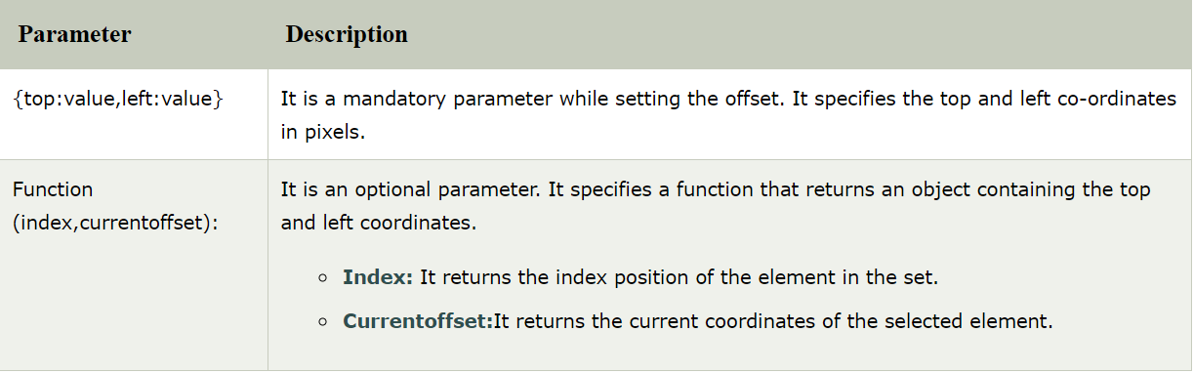
Syntax:
To RETURN the offset co-ordinates:
$(selector).offset()
To SET the offset co-ordinates:
$(selector).offset({top:value,left:value})
To SET offset co-ordinates using a function:
$(selector).offset(function(index,currentoffset))

Slide 34
jQuery position()
The jQuery position () method makes you able to retrieve the current position of an element relative to the parent element.
It returns the position of the first matched element.
This method returns the object with two properties: top and left position in pixels.
Syntax:
$(selector).position()
Notes:
Difference between offset and position
https://www.youtube.com/watch?v=zOhh3CO247k

Slide 35
jQuery addClass()
The addclass() method is used to add one or more class name to the selected element.
This method is used only to add one or more class names to the class attributes not to remove the existing class attributes.
If you want to add more than one class separate the class names with spaces.
Syntax:
$(selector).addClass(classname,function(index,oldclass))

Slide 36
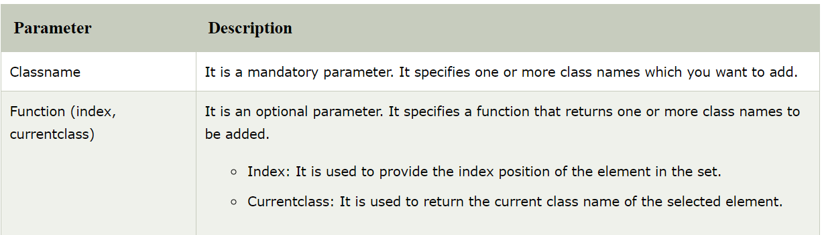

Slide 37
jQuery width()
jQuery width() method is used to return or set the width of matched element.
To return width: When this method is used to return the width, it returns the
width of first matched element.
To set width: When this method is used to set the width, it sets the width for
every matched element.
This method is one of a jQuery dimension.
List of jQuery dimension:
width()
height()
innerWidth()
innerHeight()
outerWidth()
outerHeight()

Slide 38
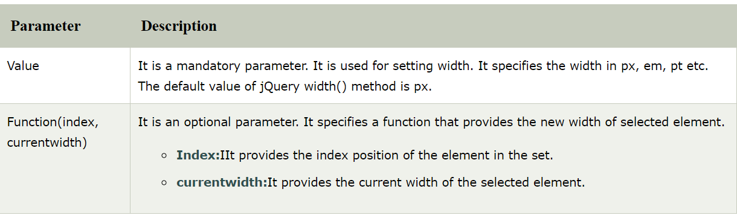
Syntax
To return the width:
$(selector).width()
To set the width:
$(selector).width(value)
To set the width using a function:
$(selector).width(function(index,currentwidth))

Slide 39
jQuery height()
The jQuery height() method is used to return the current computed height for the first element or set the height of every matched element.
you can say that the height() method is used for two purposes:
To return height: When this method is used to return height, it returns the height of first matched element.
To set height: When this method is used to set height, it sets height of all matched elements.

Slide 40
Syntax
To return the height:
$(selector).height()
To set the height:
$(selector).height(value)
To set the height by using a function:
$(selector).height(function(index,currentheight))

Slide 41
jQuery innerWidth()
jQuery innerWidth() method is used to return the inner width of the first matched element without including border and margin.
This method includes padding but excludes border and margin.
Syntax:
$(selector).innerWidth()

Slide 42
jQuery innerHeight()
The jQuery innerHeight () method is used to return the inner height of first matched element.
It includes padding but not border and margin.
Syntax:
$(selector).innerHeight()

Slide 43
jQuery outerWidth()
jQuery outerWidth() method is used to return the outer width of the first matched
element with padding and border.
The jQuery outerWidth () method works for both visible and hidden elements.
Syntax:
$(selector).outerWidth(includeMargin)
Notes:
This method accepts single parameter includeMargin which is optional. It contains boolean value and used to specify whether the margin to be included or not. If includeMargin is set to true then margin included otherwise margin not included. By default the includeMargin set to false.

Slide 44
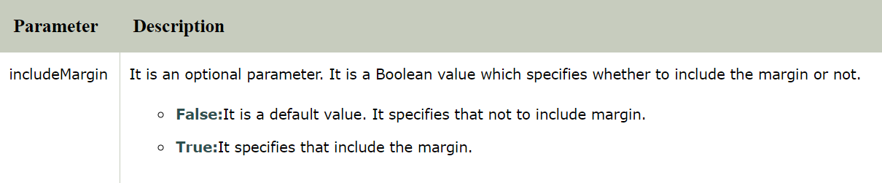

Slide 45
jQuery outerHeight()
The jQuery outerHeight () method is used to return the outer height of first matched element.
This method includes padding and border both.
In the above example, you can see that border and padding both are included in the outerHeight() method.
Syntax:
$(selector).outerHeight(includeMargin)

Slide 46
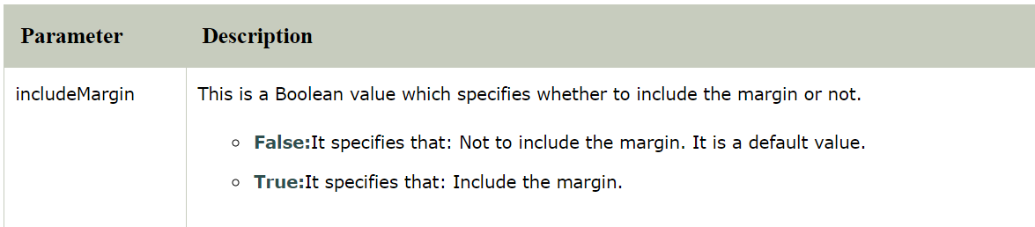

Slide 47
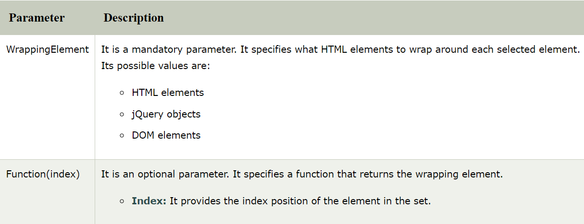
jQuery wrap()
jQuery wrap() method is used to wrap specified HTML elements around each selected element. The wrap () function can accept any string or object that could be passed through the $() factory function.
Syntax:
$(selector).wrap(wrappingElement,function(index))

Slide 48
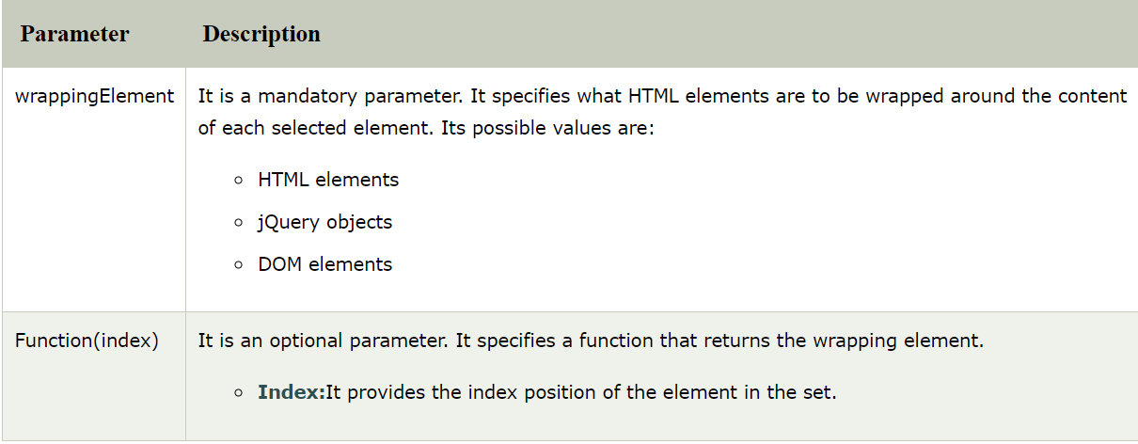
jQuery wrapInner()
The jQuery wrapInner() method is used to wrap an HTML structure around the content of each element in the set of matched element. This method can accept any string or object that could be passed to the $() factory function.
Syntax:
$(selector).wrapInner(wrappingElement,function(index))
Notes:
Return Value: This method returns the selected element with the applied changes.

Slide 49
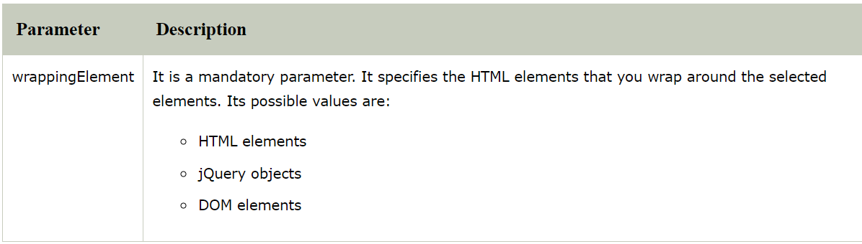
jQuery wrapAll()
jQuery wrapAll() method is used to wrap specified HTML elements around all selected elements, in a set of matched elements.
Syntax:
$(selector).wrapAll(wrappingElement)

Slide 50
jQuery unwrap()
The jQuery unwrap() method is used to remove the parent element of the selected elements.
Syntax:
$(selector).unwrap()

